Slide 1

Structs
Prof. Dr. Alp KUT
Asst. Prof. Dr. Derya BİRANT

Slide 2
OUTLINE
Motivation
What is a Struct?
Struct Examples
Nested Structs
Structs and Arrays

Slide 3
Motivation
Data Types
  Basic types: char, int, float, double
  Arrays: a collection of indexed-variables with the same type
To model real-life types, we need to be able to create user-defined data types
Solution: structures

Slide 4
What is a Struct?
A struct is a composite data type that holds data that may consist of many fields.
A struct (short for STRUCTURE), is a collection of a fixed number components of different types.
Components in a struct are called FIELDS, and are accessed by their name.
Example:
struct Human {
string Name
int Age
double Height
}

Slide 5
Struct Examples
Example 1
Example 2
struct Album {
string Name
string Artist
int NumTracks
}
struct Employee {
int Identification_number
string Name
double Salary
}

Slide 6
Struct Example
Give an example struct related with student.
struct Student {
int Student_Number
string Name
double Midterm
double Homeworks
double Final_Exam
}

Slide 7
Structs in C#
To define a structure use struct keyword
A structure should be defined at the outside of Main procedure.
When defining the fields of the struct, you should use public keyword
To access a field of a structure use "."

Slide 8
Structs in C# (Example)
struct Human
{
public string Name;
public int Age;
public double Height;
}
static void Main(string[] args)
{
Human h;
h.Name = "Ali";
h.Age = 25;
h.Height = 1.7;
Console.WriteLine(h.Name + " " + h.Age + " " + h.Height);
}
Define a struct
Declare a struct variable
Accessing to the fields

Slide 9
Example 1
Write a program that adds two complex numbers by using structs.
Note: A complex number is a number which is often formally defined to consist of an ordered pair of real numbers (a,b), often written:

Slide 10
Example 1 (Answer)
struct ComplexNumber
{
public int a;
public int b;
}
static void Main(string[] args)
{
ComplexNumber compnumber1;
ComplexNumber compnumber2;
ComplexNumber result;
compnumber1.a = 3;
compnumber1.b = 5;
compnumber2.a = 1;
compnumber2.b = 2;
result.a = compnumber1.a + compnumber2.a;
result.b = compnumber1.b + compnumber2.b;
Console.WriteLine(result.a + " " + result.b); }

Slide 11
Example 2
Write a program that computes the distance between 2D points.
p1
p2

Slide 12
Example 2 (Answer)
struct Point
{
public int x;
public int y;
}
static void Main(string[] args)
{
Point p1;
Point p2;
double distance;
p1.x = 1;
p1.y = 2;
p2.x = 3;
p2.y = 2;
distance = Math.Sqrt( Math.Pow((p1.x - p2.x),2) + Math.Pow((p1.y - p2.y),2));
Console.WriteLine(distance);
}
p1
p2

Slide 13
Nested Structures
A nested structure is a structure that contains one or more other structures as components.
Example:
struct Date
{
public int day;
public int month;
public int year;
};
struct Human
{
public string name;
public int age;
public Date birthdate;
}

Slide 14
Nested Structure - Example 1
struct Date
{
public int day;
public int month;
public int year;
};
static void Main(string[] args)
{
Human h;
h.name = "Ali";
h.age = 25;
h.birthdate.day = 27;
h.birthdate.month = 3;
h.birthdate.year = 1983;
Console.WriteLine(h.name);
Console.WriteLine(h.age);
Console.WriteLine(h.birthdate.day +"." + h.birthdate.month +"."+ h.birthdate.year);
}
struct Human
{
public string name;
public int age;
public Date birthdate;
}

Slide 15
Nested Structure - Example 2
struct Adress {
public string city;
public string state;
public int pin;
}
struct Employee {
public string name;
public int age
public double sal;
public Adress adr;
}
static void Main(string[] args)
{
Employee emp;
emp.name = "Ali";
emp.age = 18;
emp.adr.city = "İzmir";
emp.adr.state = "Ege Bölgesi";
}

Slide 16
Nested Structure - Example 3
Define two structured variables (L1 and L2) to store the following two lines
2
3

Slide 17
Nested Structure - Example 3
public struct Point
{
public int x;
public int y;
}
struct Line
{
public int length;
public Point p1;
public Point p2;
}
static void Main(string[] args)
{
Line L1;
Line L2;
L1.length=3;
L1.p1.x=1;
L1.p1.y=1;
L1.p2.x=4;
L1.p2.y=1;
L2.length=2;
L2.p1.x=1;
L2.p1.y=3;
L2.p2.x=3;
L2.p2.y=3;
}
2
3

Slide 18
Structs and Arrays
Arrays: a collection of indexed-variables with the same type
A structure can be the basic type of an array.
Example:
struct Student
{
public int number;
public string name;
public double module_grade;
}
Student[] classroom = new Student[142];

Slide 19
Structs and Arrays
public struct Student
{
public int number;
public string name;
public double grade;
}
static void Main(string[] args)
{
Student[] classroom = new Student[142];
classroom[0].number= 2013510016;
classroom[0].name = "ALİ TAŞ";
classroom[0].grade = 93.0;
Console.WriteLine(classroom[0].number);
Console.WriteLine(classroom[0].name);
Console.WriteLine(classroom[0].grade);
}

Slide 20
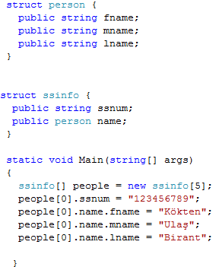
Structs and Arrays

Slide 21
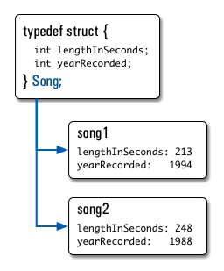
Structs and Arrays
Write a program that stores and lists all Micheal Jackson’s songs.
...

